Slide 1
Ergonomic posture in static and motion
By: Ari (Sara) Wahl, Nourhan Omar, Pavlo Kravets, Polina Kozyr and Vipin Singh

Slide 2
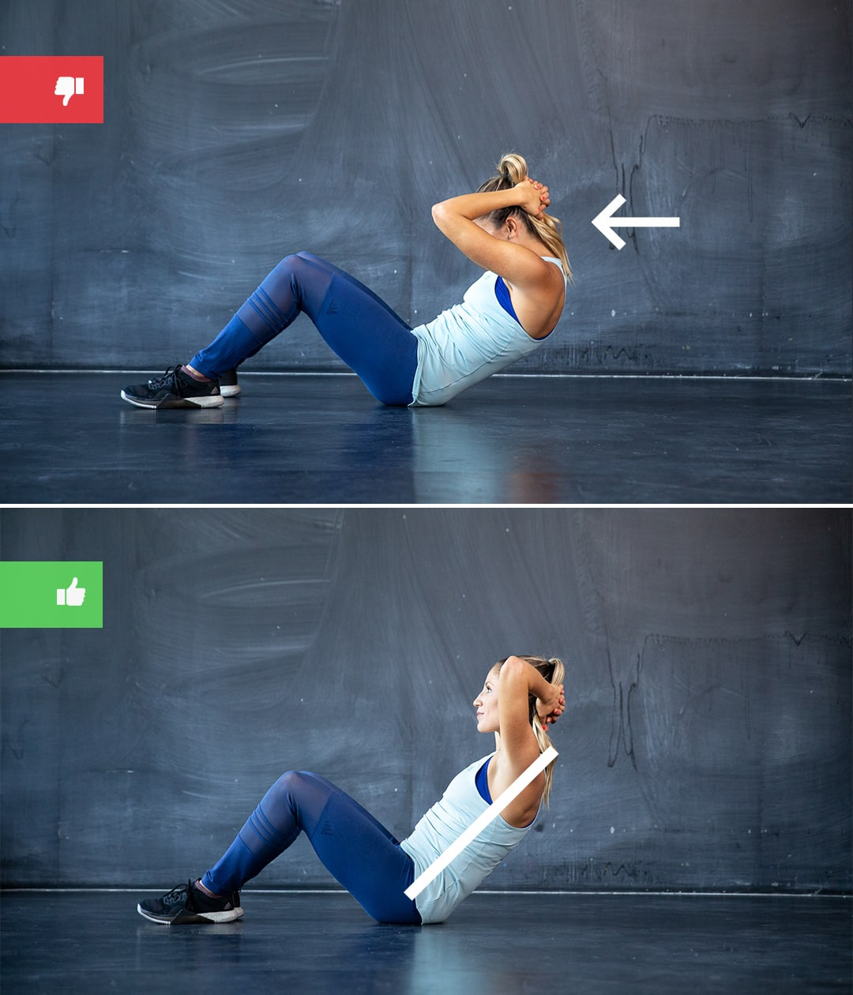
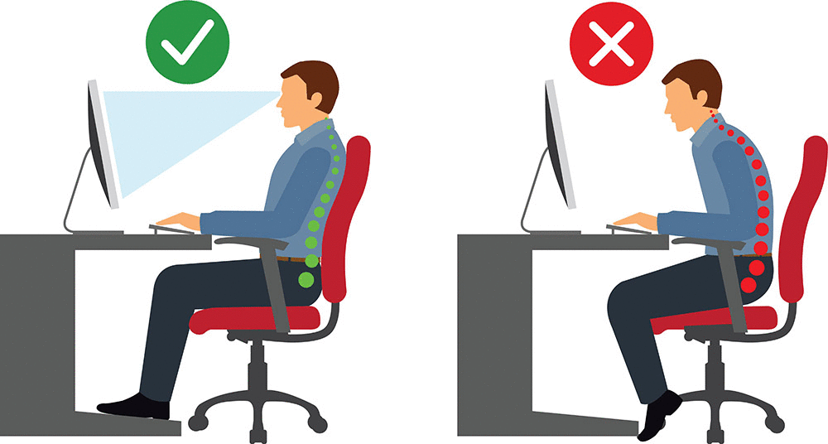
Business Idea Proposal
The main value proposition of the app is people can become healthier and get rid of/prevent pain caused by bad posture
The product is an app that uses image processing and movement detection
The MVP (minimal value product) is posture detection app to help people with ergonomics in their home offices
Future developments include support for working out and possibly physical therapy

Slide 3
Image sources
https://www.healthdirect.gov.au/how-to-improve-your-posture
https://www.runtastic.com/blog/en/bodyweight-exercise-mistakes/

